Slide 1




Slide 3
Team Members
1) Bhavya Chauhan (110124089) - Full-stack Developer, DevOps Engineer
2) Dhaval Trivedi (110123934) - Full-stack Developer, Scrum Master
3) Chandana Sree Sunkara (110100976) - Full-stack Developer, QA Tester
4) Mahima Rashmi (110122783) - Full-stack Developer, QA Tester
5) Malharsingh Thakur (110123181) – Full-stack Developer, Project Manager
6) Ruchibahen Nakum (110122972) - Full-stack Developer, DevOps Engineer
7) Umer Mahmood Khan (110110253) - Full-stack Developer, UI/UX designer
RecruitEase

Slide 4
Problem Statement
The global economic situation has led to a scarcity of suitable jobs, making it challenging for job seekers to find employment. The application aims to assist job seekers in developing new skills through courses offered by companies, increasing their employability. Simultaneously, it provides companies with access to a pool of qualified applicants with demonstrated skills during the recruitment process.
RecruitEase

Slide 5
Proposed Solution
The proposed solution is an online education app which addresses the challenges of unemployment by providing:
Interactive video lessons
Personalized learning paths
Progress tracking
Course marketplace
Certification and accreditation
These solutions aim to provide a seamless and effective learning experience for students while enabling companies to deliver high-quality training courses, manage student progress and make data-driven decisions to improve their courses.
RecruitEase

Slide 6
Unique Selling Point
Future Possibility of getting hired in dream company
Learning Industrial specific courses
Company Certification
Opportunity of working on real life projects
RecruitEase

Slide 7

1
Targeted
Audience
Students: This group includes learners at various stages of their academic journey, from high school students exploring career paths to university students seeking to enhance their skills.
Job seekers: This group comprises individuals who are actively seeking employment or looking to improve their skills to increase their chances of getting hired.

Slide 8

APPLICATION FEATURE
01
PROJECT FLOW
02
AGENDA
UI/ UX DESIGNS
03
04
SDLC

Slide 9

FUNCTIONAL AND
NON-FUNCTIONAL
01
Functional Requirements
User Registration
Course Enrollment
Forget Password
User Login
Display Profile
Course Content
02
APPLICATION
FEATURE
03
Non-Functional Requirements
04
Reliability
Scalability
Compatibility
Performance
Maintainability

Slide 10
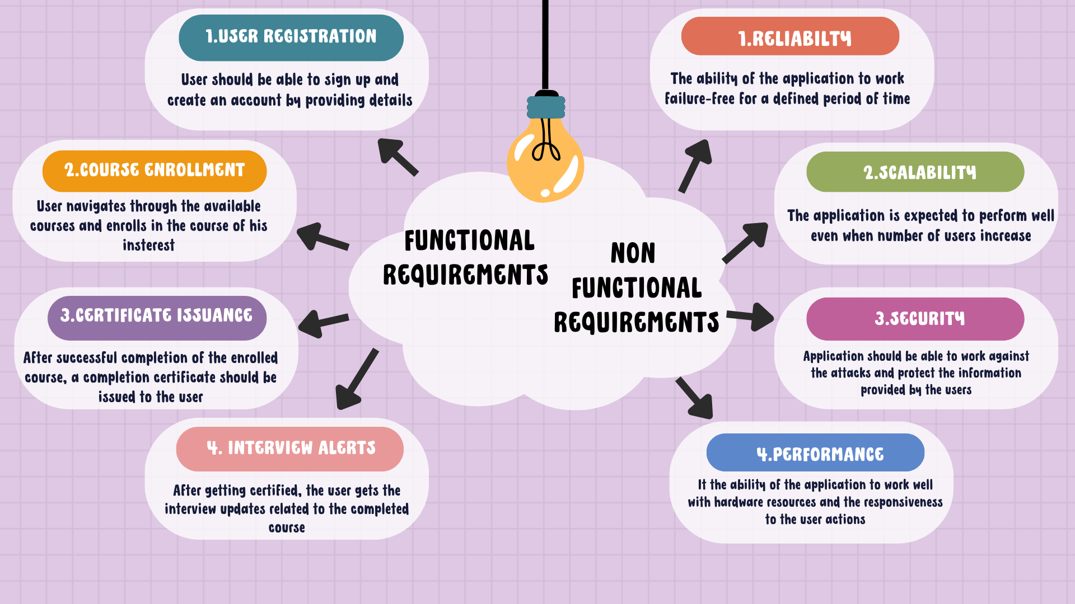

Slide 11

01
SEQUENCE OF APPLICATION
ACTIVITIES
02
PROJECT
FLOW
Application Workflow
03
Plan of preset sequence of activities to develop and maintain the application.
04

Slide 12
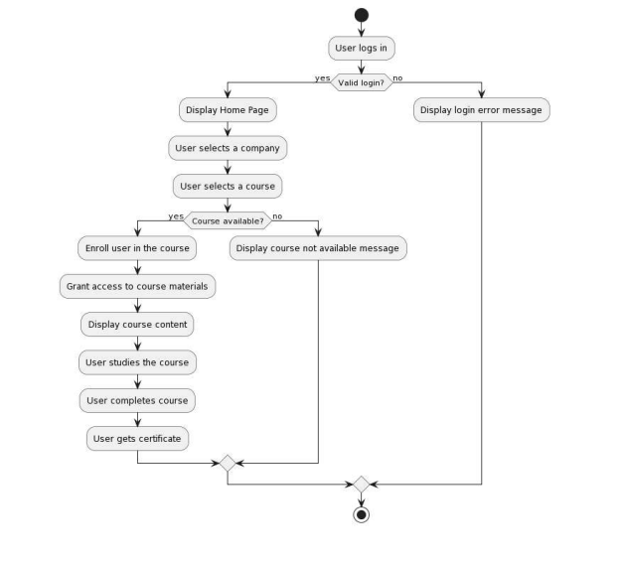

Slide 13

01
02
UI/UX
DESIGNS
03
APPLICATION PAGE LAYOUTS
04
Graphical User Interface
Simplified user interface designs

Slide 14
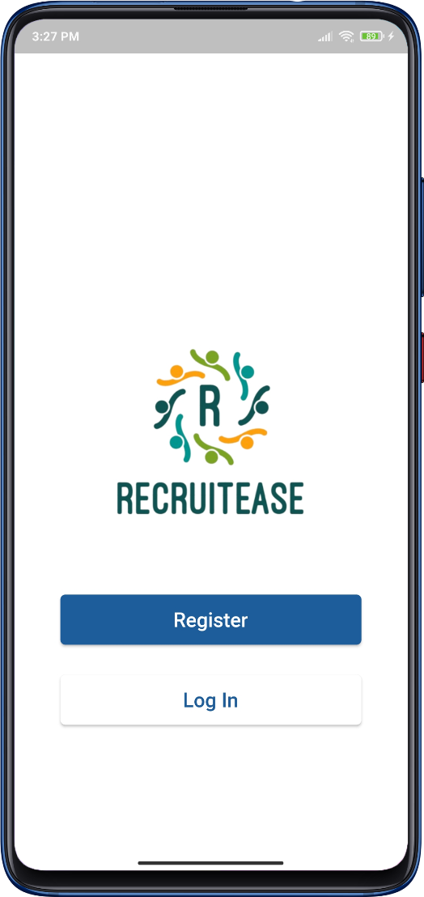
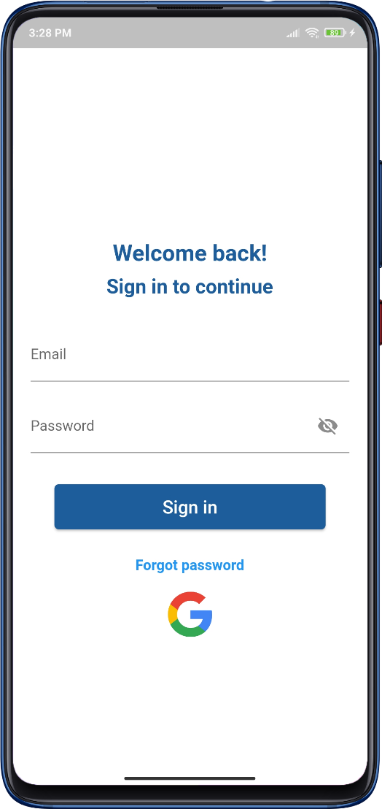
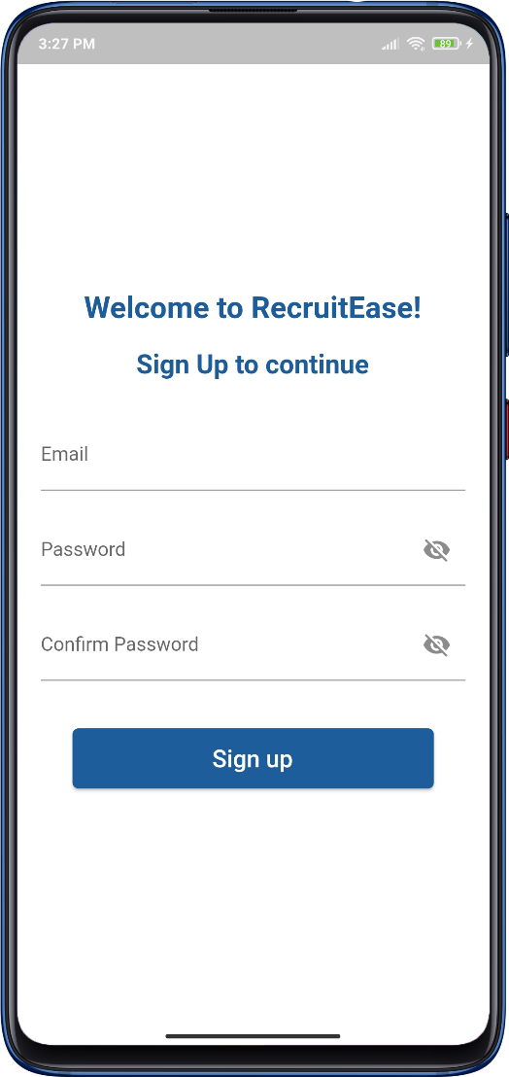
Welcome Screen
Sign In
Screen
Sign Up
Screen

Slide 15
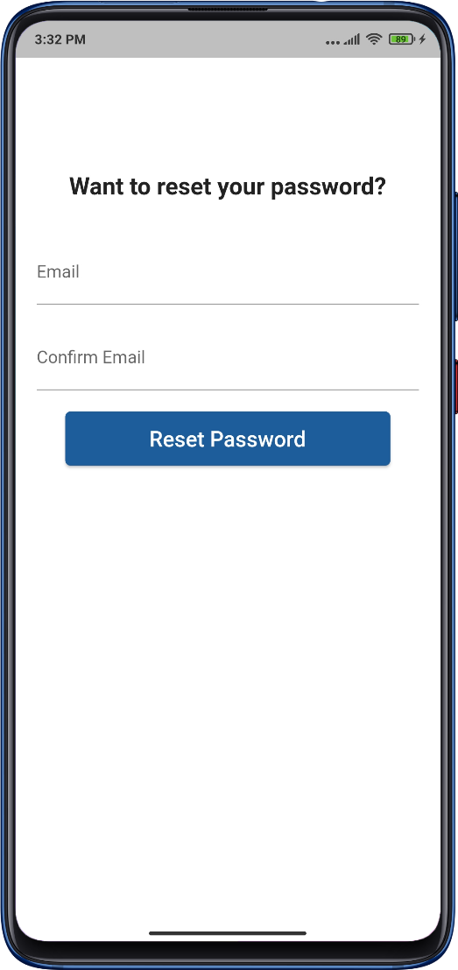
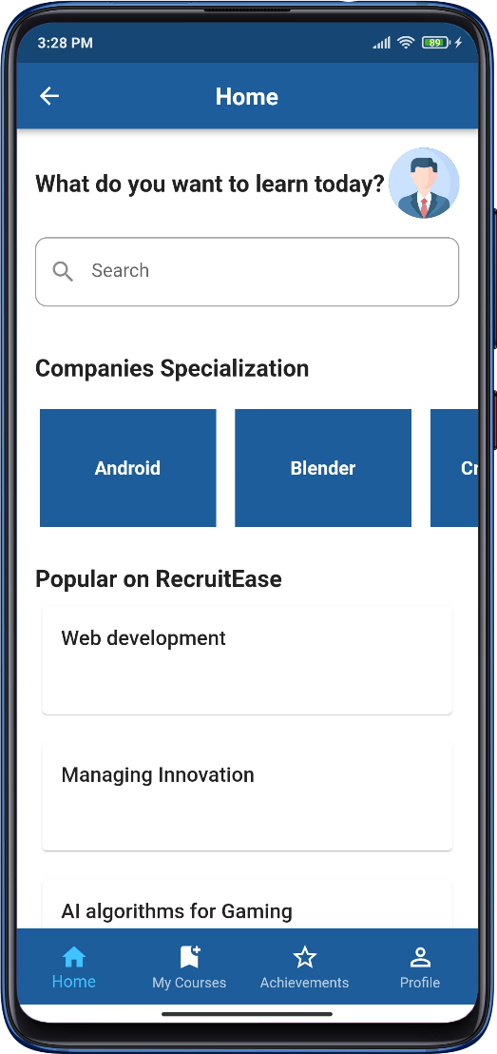
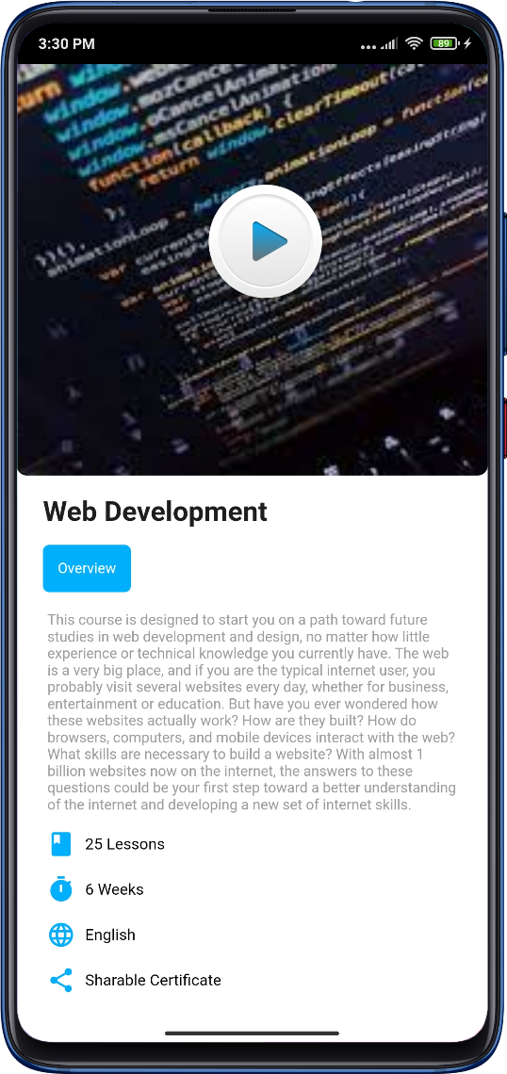
Forget Password
Screen
Home Page
Screen
Course Overview
Screen

Slide 16
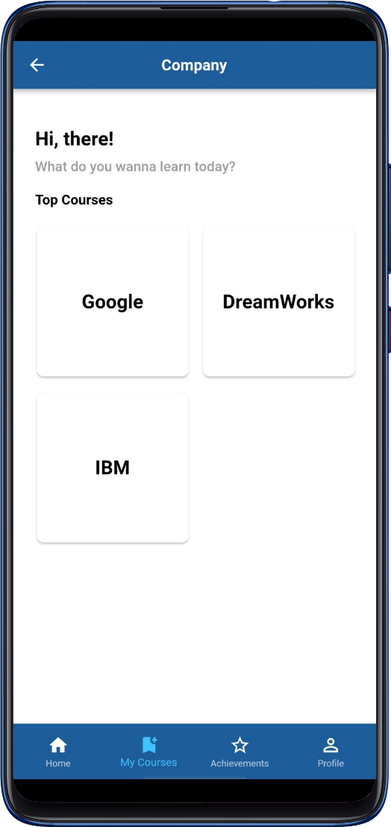
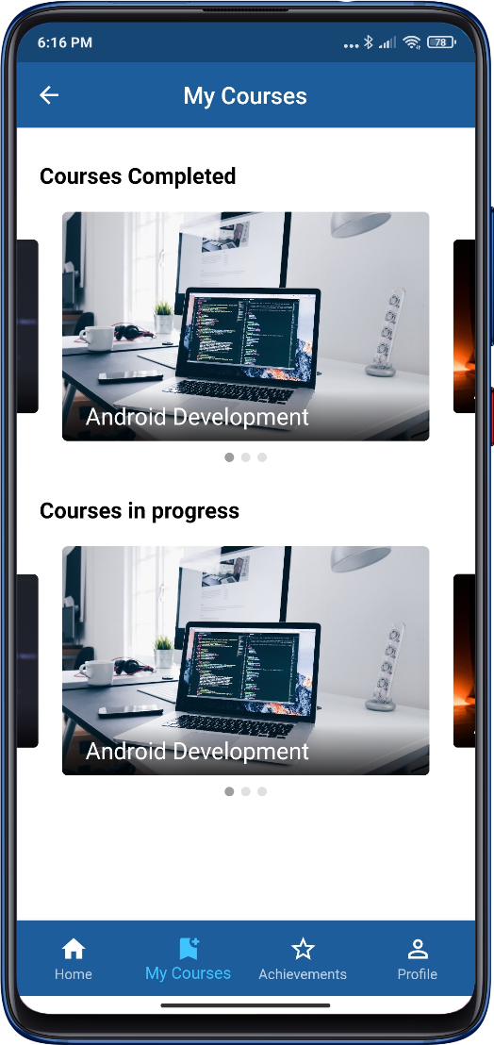
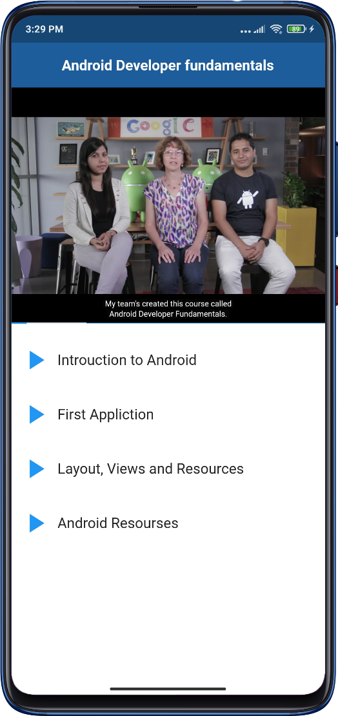
My Course Page
Screen
Company Course Detail
Screen
Video Player
Screen

Slide 17
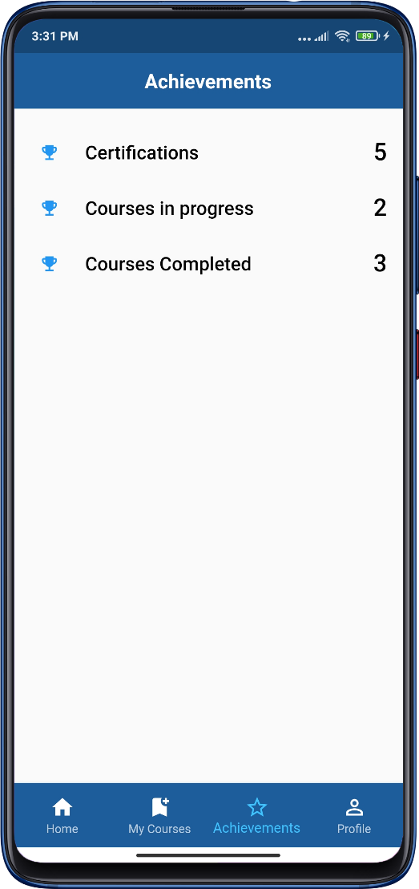
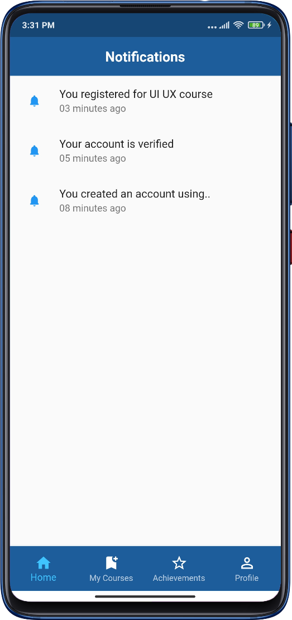
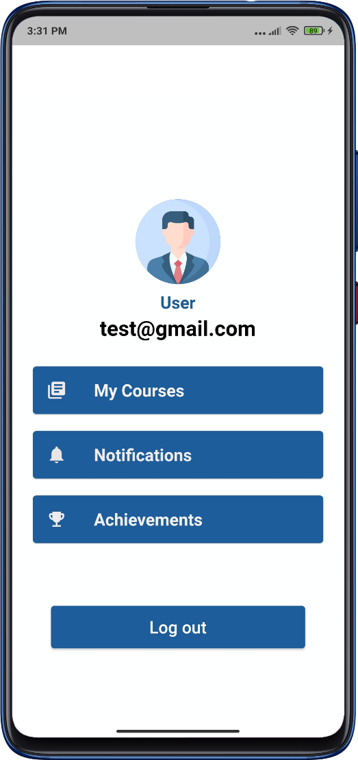
Achievement
Screen
Notification
Screen
Profile
Screen

Slide 18
Achievement
Screen
Notification
Screen

Slide 19
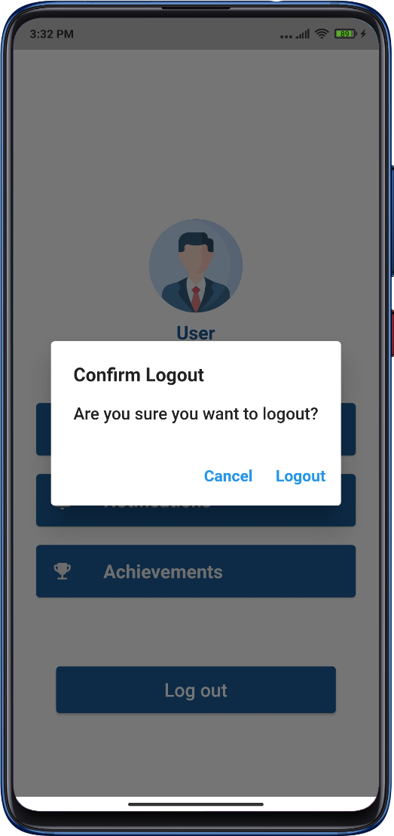
Profile
Screen
Logout
Screen

Slide 20

01
02
Software Development Methodology
Agile framework for collaborative and iterative project management
SDLC
03
04
SCRUM

Slide 21
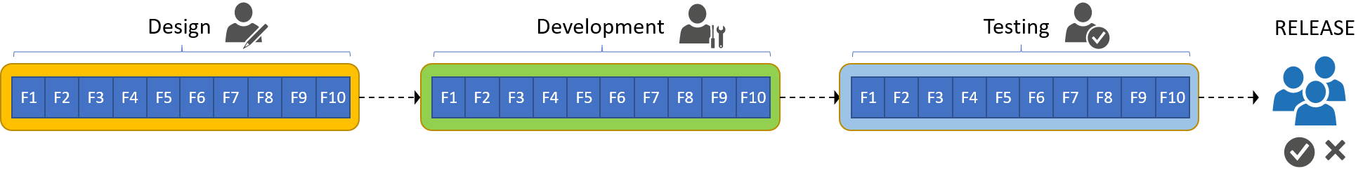
Software Development Lifecycle (SDLC)
We are maintaining the project utilising the Agile Methodology and Scrum Framework for software development. The following factors have influenced our decision:
By using sprint planning, we can establish shared objectives and keep everyone informed.
Daily scrum sessions will allow us to communicate with every team member and learn about any obstacles they may be facing.
So that we can provide the highest-quality product possible, Scrum will enable us to include testing as part of the sprint cycle.
We will be able to clearly identify our duties and concentrate on what we are doing thanks to Scrum.
Twice weekly scrum stand-up meetings are scheduled, and a sprint retrospective meeting will be held at the conclusion of the sprint to comprehend and review all the work completed during that time.

Slide 22
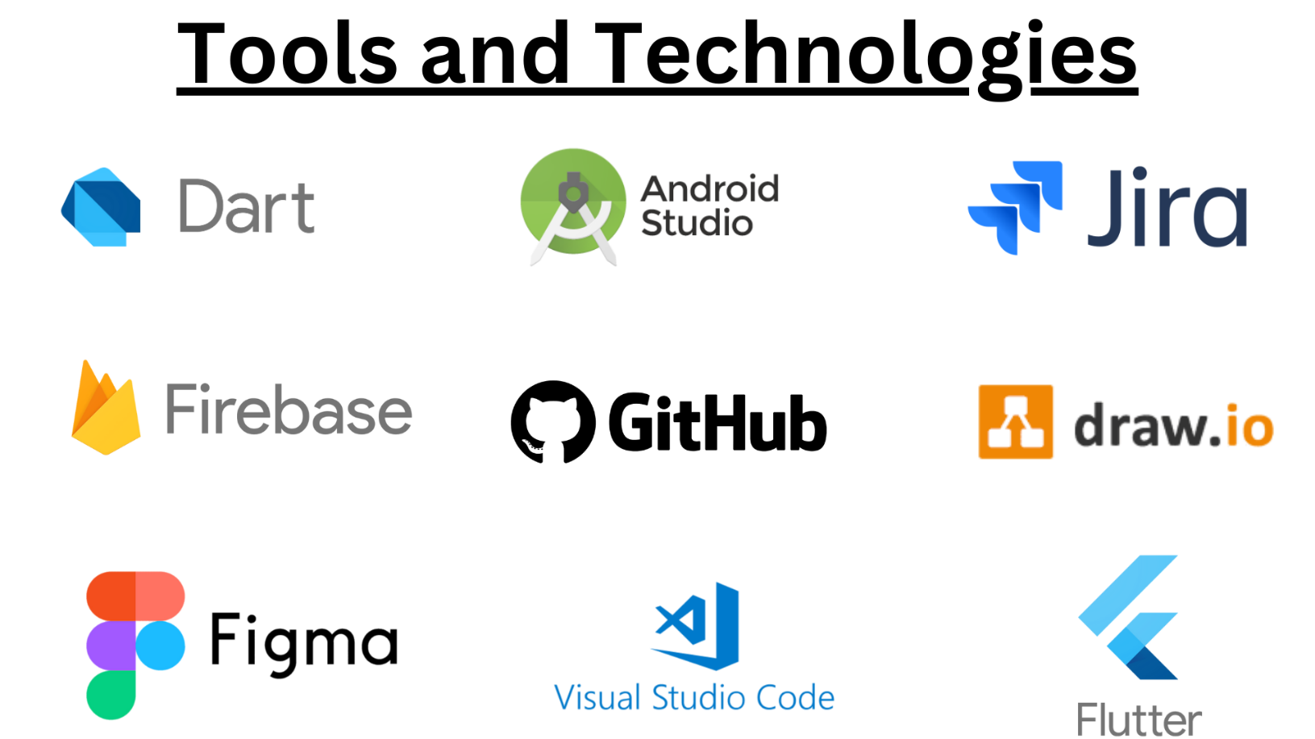
Technology Stack

Slide 23
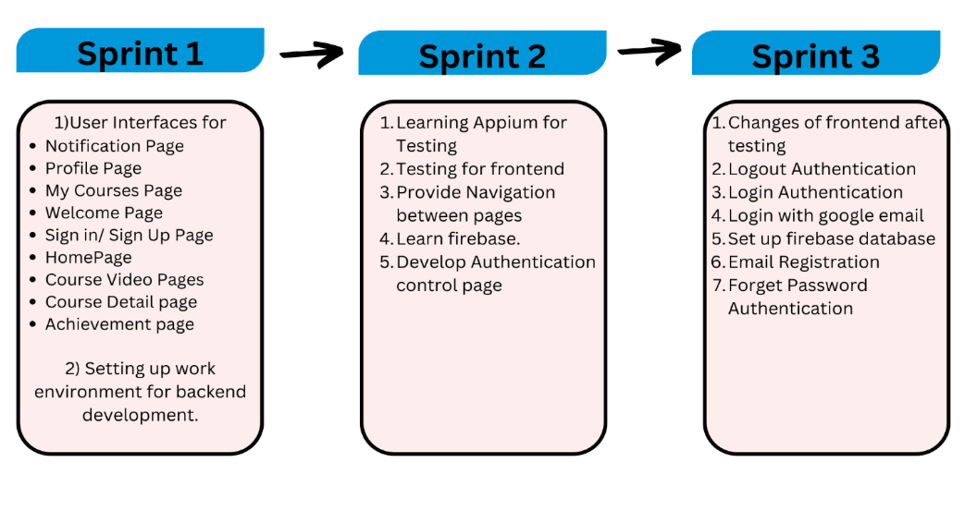
1
Sprint Details

Slide 24
Sprint Review
Sprint 1
(Frontend Developing)
Timeline :- 14th June 2023 to 21st June 2023
Milestone :- 22nd June 2023
Initialization of Sprint
Requirement Gathering
Meeting Setup (30 minutes) : 20th June 2023
Query Logging (3 hours) : 21st June 2023
Query Discussion Meeting with Customer : 22nd June 2023
Requirement Analysis
The scrum team will compile all the requirements based on the query discussion meeting with the end-user.
Sprint Backlog Meeting
The sprint's objectives have been established, with a focus on the milestone deliverables that will be presented to the customer.

Slide 25
Sprint Review
Sprint 2
(Backend Developing and Testing)
Timeline :- 22nd June 2023 to 5th July 2023
Milestone :- 6th July 2023
Initialization of Sprint
Requirement Gathering
Meeting Setup (30 minutes) : 4th July 2023
Query Logging (3 hours) : 5th July 2023
Query Discussion Meeting with Customer : 6th June 2023
Requirement Analysis
The scrum team will compile all the requirements based on the query discussion meeting with the end-user.
Sprint Backlog Meeting
The sprint's objectives have been established, with a focus on the milestone deliverables that will be presented to the customer.

Slide 26
Sprint Review
Sprint 3
(Testing and Release)
Timeline :- 6th July 2023 to 19th July 2023
Milestone :- 22th July 2023
Initialization of Sprint
Requirement Gathering
Meeting Setup (30 minutes) : 18th July 2023
Query Logging (3 hours) : 19th July 2023
Query Discussion Meeting with Customer : 20th July 2023
Requirement Analysis
The scrum team will compile all the requirements based on the query discussion meeting with the end-user.
Sprint Backlog Meeting
The sprint's objectives have been established, with a focus on the milestone deliverables that will be presented to the customer.

Slide 27
1
Unit Testing :
It tests individual components or units of code in isolation. It ensures that each unit functions correctly as expected and meets its specified requirements.
We conducted on specific features like if the user is being able to move between pages correctly.
Testing
Acceptance Testing:
It ensures that the mobile application meets the business and user requirements. It is also known as User Acceptance Testing (UAT).
We conducted this testing by contacting potential user to verify that it fulfills its intended purpose effectively.

Slide 28
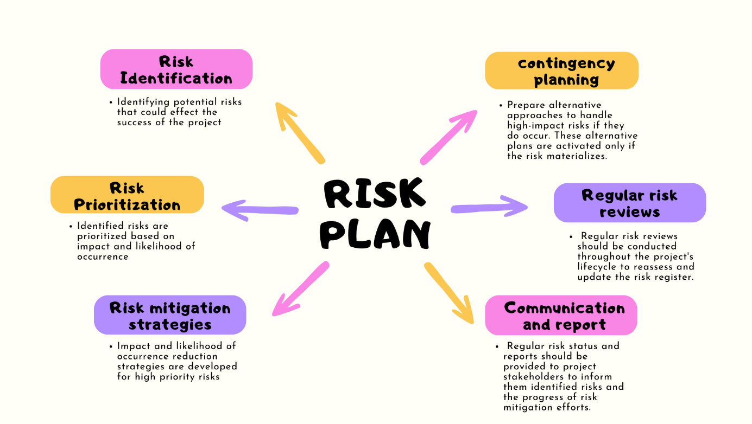
Risk Management

Slide 29
1
Future milestones
Data Analytics for Continuous development
Gamification to make learning more engaging and fun.
Integration with Job Market Trends
Corporate Training Solutions.
Integration with Conventional Educational Institutions
AI-Driven Personalization.

Slide 30
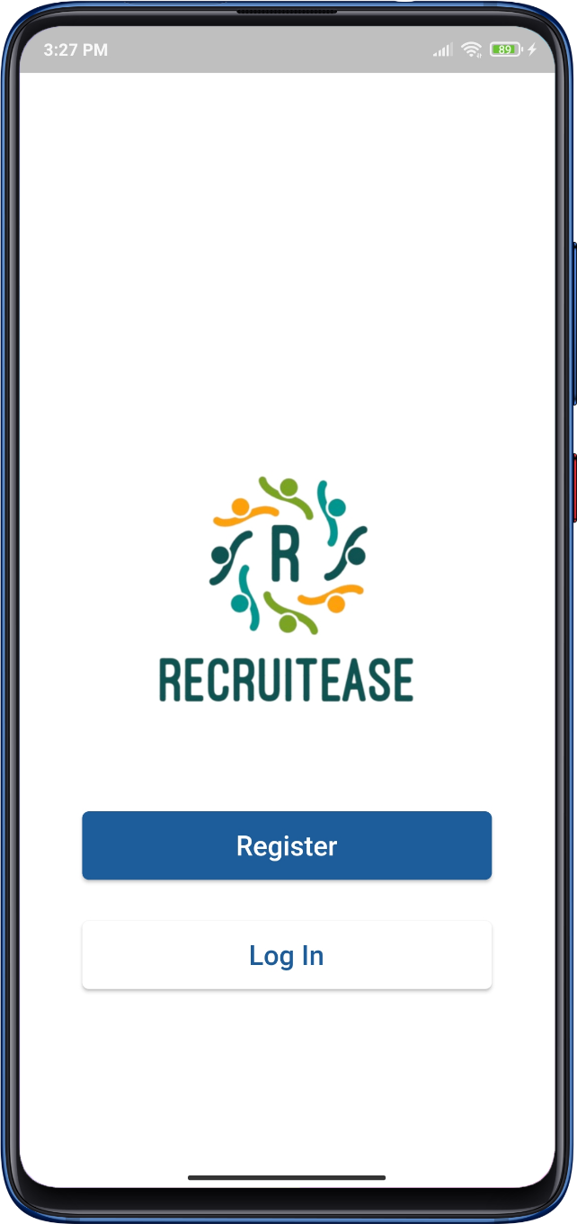
App Demo

Slide 31
Any Questions/
Suggestions?

Slide 32
Thanks

